Slide 1


2nd International Conference on Sustainable Computing and Smart Systems (ICSCSS 2024)
“Image-Based Dimension Extraction of Flowers’ and Classification with SFFFP Neural Network”
Paper ID: 167
Roumo Kundu, Swayam Gupta, Mohan Kumar Dehury, Tannisha Kundu, Madhusudan Narayan, Asit Kumar Mohapatra
Presented by - ROUMO KUNDU
Amity University Jharkhand Ranchi, India

Slide 2
Contents
Introduction
Background and Problem Statement
Plausible Solution
Related Work
Dataset and Nature
Methods and Mechanisms
Result and Performance
Performance Analysis
Conclusion

Slide 3
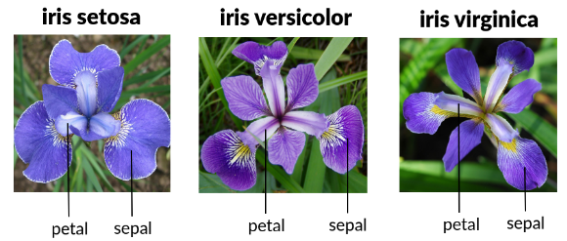
Introduction
AI is transforming botany, with researchers exploring new techniques for automated plant identification and classification.
Traditional methods often struggle with accurately extracting meaningful features from image data.
This work proposes a deep learning-based approach for tri-petal species of flower classification.
The model uses a Sequential Fast-Forward Feedforward Perceptron Neural Network (SFFPN) to analyze iris flower images and extract relevant features.
SFFPNs, also known as Multi-Layer Perceptrons (MLPs), allow the network to learn complex relationships between input image data and desired classification output.
Variety of Iris Flower as a Test Subject for the Experimentation

Slide 4
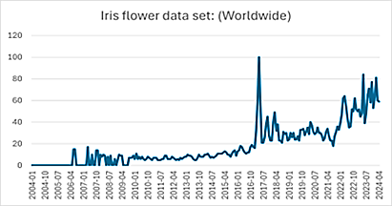
Background and Problem Statement
• SFFPN trained on iris flower images for tri-petal flowers.
• Network learns to extract features like sepal and petal dimensions.
• Classifies flowers into respective species (Iris setosa, Iris versicolor, Iris virginica).
• Eliminates need for manual feature extraction, circumventing limitations of pre-measured datasets.
• Global popularity of Iris flower dataset illustrated in .
• Proposes novel solution for iris flower classification, paving way for robust, automated image-based plant identification systems.
Familiarity with usability of IRIS Flower Dataset over the past years

Slide 5
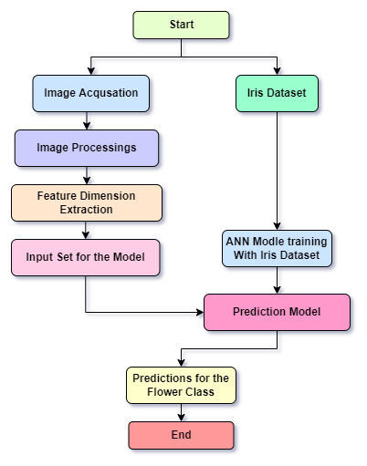
Plausible Solution
Utilizes photogenic sensors for sensing Floral Dimensions.
Finds optimized algorithmic structure for efficient use.
Uses acquired dimensions as input variables for Artificial Neural Net Model for 150 epoch predictions.
. Workflow Algorithm of the Proposition

Slide 6
Related Work
Advances in computer vision and deep learning, coupled with smartphone technology, enable efficient crop disease identification. Training a neural network on a dataset of 54,306 plant images achieved 99.35% accuracy, showing promise for global-scale smartphone-assisted diagnosis, vital for food security. [2]
Presents a novel image deblurring method that doesn't require blur kernel estimation. It uses paired images captured in low light: one blurred and one noisy. By extending Gaussian mixture models and employing optical flow, it achieves superior deblurring results compared to existing techniques, especially for complex blur types. [10]
Employing CNNs, Deep Belief Networks, and Autoencoders. Advancements include feature learning and unsupervised training, yet challenges persist in optimizing model selection and understanding efficacy in tasks. [4]
A high-precision Sigmoid activation function (AF) neuron circuit for Artificial Neural Networks (ANNs). It achieves a 1.76% error fitting the Sigmoid function in TSMC 0.18𝜇m CMOS technology, demonstrating noise resilience and potential for large-scale systems. [13]

Slide 7
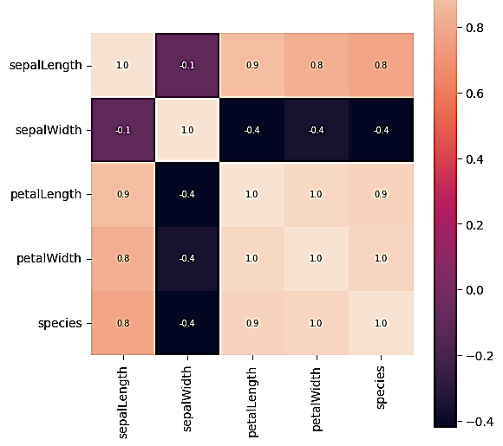
Dataset and Nature
sepalL | sepalW | petalL | petalW | species
5.1 | 3.5 | 1.4 | 0.2 | 0
4.9 | 3.0 | 1.4 | 0.2 | 0
4.7 | 3.2 | 1.3 | 0.2 | 0
4.6 | 3.1 | 1.5 | 0.2 | 0
(150, 6)

Slide 8
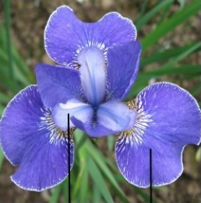
Dataset and Nature
Sample Image for the Experimented Image Based Algorithm

Slide 9
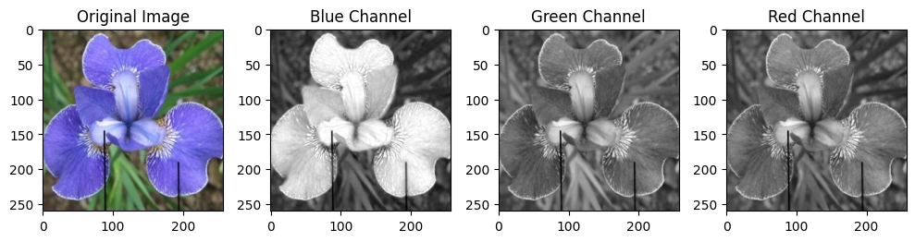
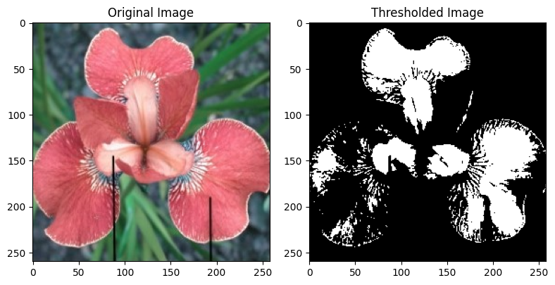
Methods and Mechanisms
Sample Image’s Color Model Split
Thresholded for the Blue Channel Image

Slide 10
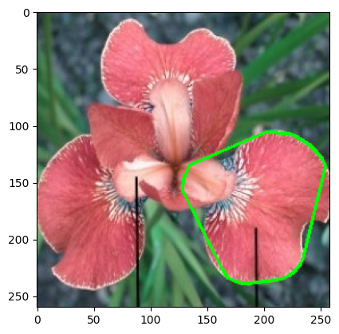
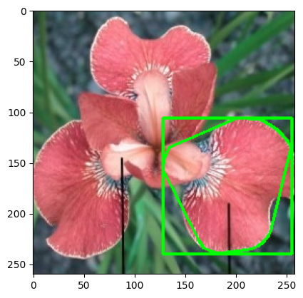
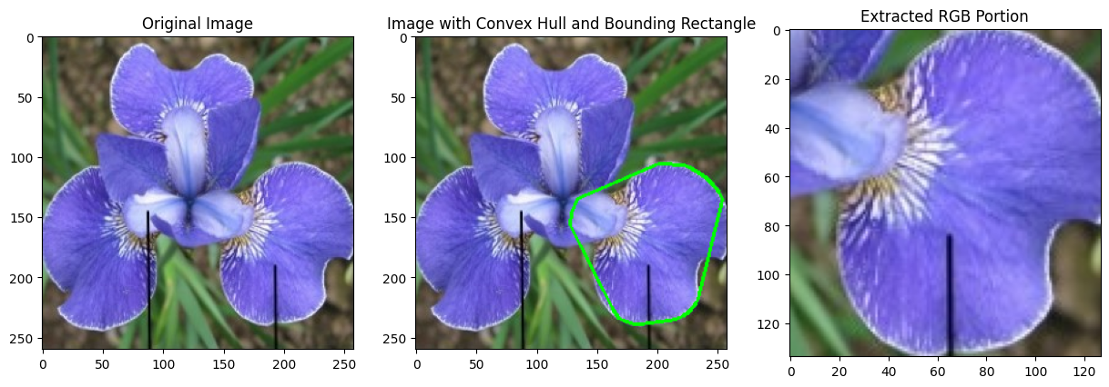
Methods and Mechanisms
Hull Convex Applied on the Blue Channel Image which Resulted in the Region of Petal

Slide 11
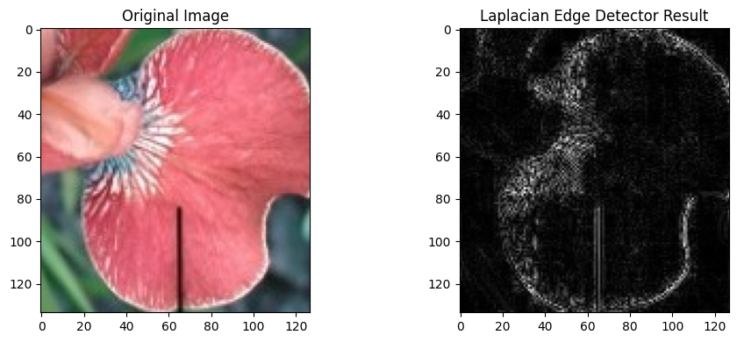
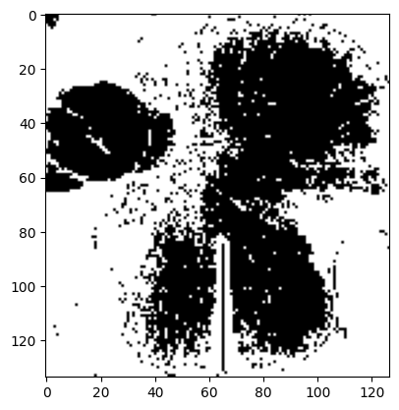
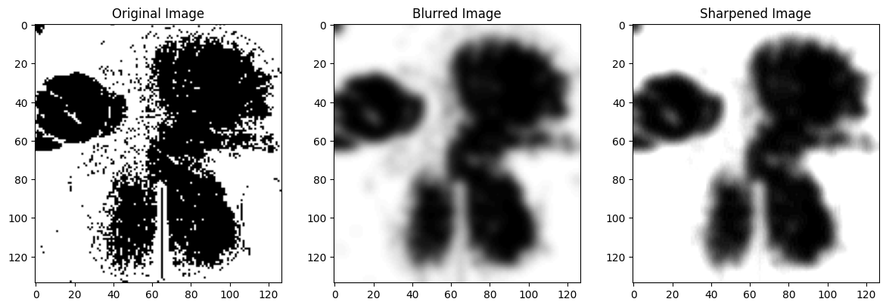
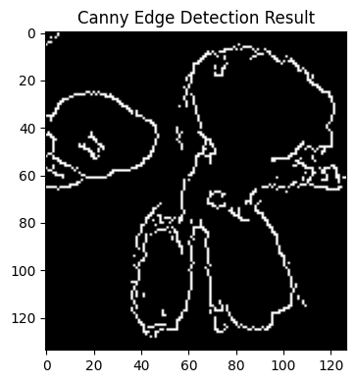
Methods and Mechanisms
Laplacian Mask on the Cropped Image
Thresholded the Resultant Image
The Thresholded Image sequenced through Gaussian Blur and Sharpening Agent
Canny Edge Detector on Sharpened Image

Slide 12
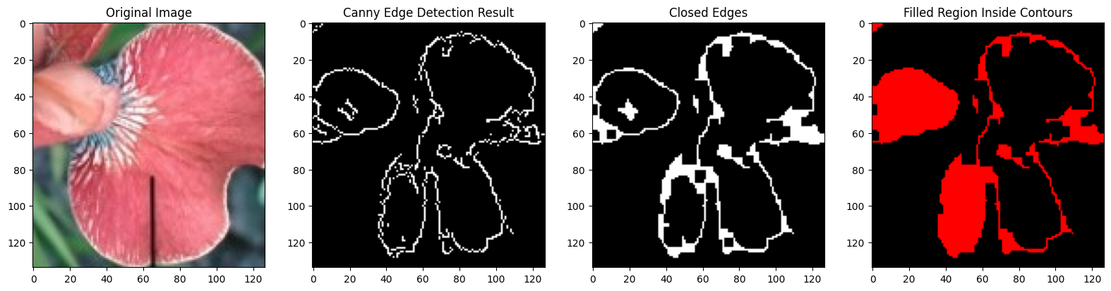
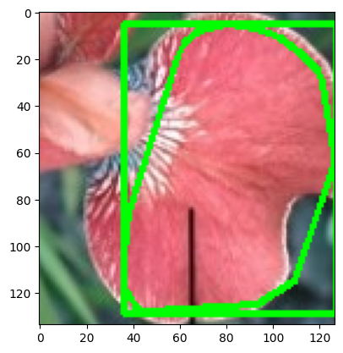
Methods and Mechanisms
Boundary Repair and Filling Technique
Spotted the Ariel Region of the Petal
Sepal Length = { p₁,q₁ } – { p₂ , q₂ }
Real-world dimension = Pixel dimension * Scaling factor

Slide 13
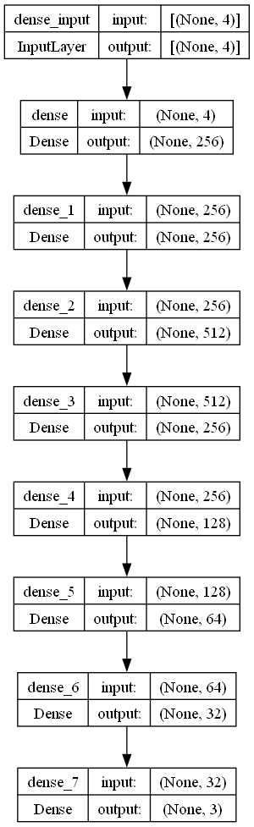
Methods and Mechanisms
SFFFP – Sequential Fast Forward Feed Perceptron Neural Net
With 150 Epochs
Batch Size 32
Adam Optimizer

Slide 14
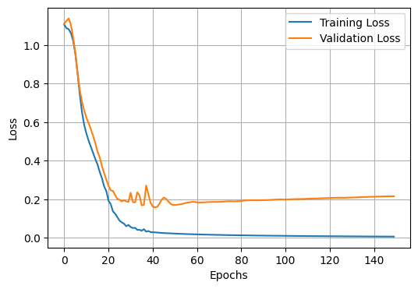
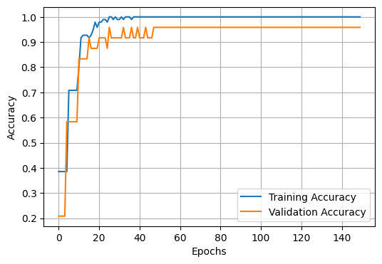
Result and Performance
Test Accuracy: 96.67%
Vali Accuracy: 95.83%

Slide 15
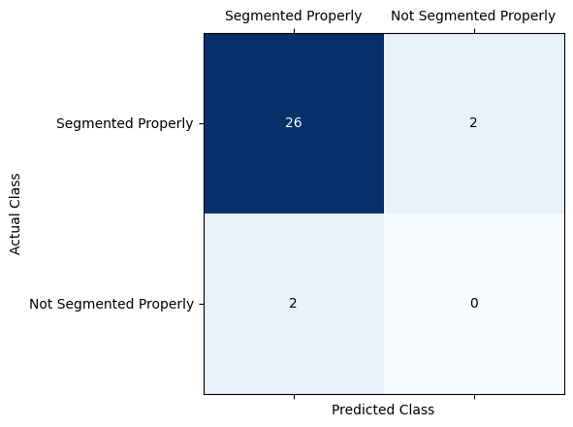
Result and Performance
True positives (26): These are the images that were correctly classified as segmented properly.
False negatives (2): These are the images that were actually segmented properly but were classified as not segmented properly by the model.
False positives (2): There were no images incorrectly classified as segmented (which would be indicated by a value in this cell).
True negatives (0): There were no images that were not segmented properly and correctly classified as such (which would be indicated by a value in this cell).
Performance metrics are:
Accuracy: 86.7 %
Precision: 92.9 %

Slide 16
Performance Analysis
Model | Performance of Accuracy
KNN [14] | 96.60
Neural Net [15] | 92.45
SVM [16] | 95.98
The Tested Model | 96.67
Test Accuracy: 96.67%
Vali Accuracy: 95.83%

Slide 17
Conclusion
• Utilizes Sequential Fast Forward Feed Perceptron Neural Network (SFFPN) for high precision accuracy.
• Utilizes light-weighted image processing and mathematical implementations to extract sepal and petal dimensions.
• Provides automatic and robust solution for iris flower classification.
• Results show effectiveness of Deep Learning models in botanical applications.
• Future research should explore sophisticated image processing methods, transfer learning from pre-trained models, and handling unbalanced datasets.
• 3-dimensional modeling for correct dimension extraction could improve plant sorting systems efficacy and precision.

Slide 18
References
Jain, V. (2019, December 30). Everything you need to know about “Activation Functions” in Deep learning models | by Vandit Jain | Towards Data Science. https://towardsdatascience.com/everything-you-need-to-know-about-activation-functions-in-deep-learning-models-84ba9f82c253?gi=5daeb148efd5
Mohanty, S P., Hughes, D., & Salathé, M. (2016, September 22). Using Deep Learning for Image-Based Plant Disease Detection. https://doi.org/10.3389/fpls.2016.01419
Ren, S., He, K., Girshick, R., & Sun, J. (2017, June 1). Faster R-CNN: Towards Real-Time Object Detection with Region Proposal Networks. https://doi.org/10.1109/tpami.2016.2577031
Voulodimos, A., Doulamis, A., Doulamis, A., & Protopapadakis, E. (2018, January 1). Deep Learning for Computer Vision: A Brief Review. https://doi.org/10.1155/2018/7068349
Wäldchen, J., & Mäder, P. (2017, January 7). Plant Species Identification Using Computer Vision Techniques: A Systematic Literature Review. https://doi.org/10.1007/s11831-016-9206-z
Yalçın, H., & Razavi, S. (2016, July 1). Plant classification using convolutional neural networks. https://doi.org/10.1109/agro-geoinformatics.2016.7577698
Gonzalez, R. C. (2009). Digital image processing. Pearson education india.
Zhang, X., Tang, Z., Yu, J., Guo, M., & Jiang, L. (2010). Convex hull properties and algorithms. Applied mathematics and computation, 216(11), 3209-3218.
Alparslan, E. (1980). Componentwise edge detection by Laplacian operator masks. Signal Processing, 2(2), 179-183.
Gu, C., Lu, X., He, Y., & Zhang, C. (2019). Blur Removal Via Blurred-Noisy Image Pair. IEEE Transactions on Image Processing, 30, 345-359. https://doi.org/10.1109/TIP.2020.3036745.
Taylor, G. (2003). Sharpening the image.. AJR. American journal of roentgenology, 181 1, 43-5 . https://doi.org/10.2214/AJR.181.1.1810043.
Banerjee, C., Mukherjee, T., & Pasiliao, E. (2020). The Multi-phase ReLU Activation Function. Proceedings of the 2020 ACM Southeast Conference. https://doi.org/10.1145/3374135.3385313.
Xing, S., & Wu, C. (2020). Implementation of A Neuron Using Sigmoid Activation Function with CMOS. 2020 IEEE 5th International Conference on Integrated Circuits and Microsystems (ICICM), 201-204. https://doi.org/10.1109/ICICM50929.2020.9292239.
Sinta, D., Wijayanto, H., & Sartono, B. J. A. M. S. (2014). Ensemble K-Nearest neighbors method to predict rice price in Indonesia. Appl. Math. Sci, 8(160), 7993-8005.
Jakkula, V. (2006). Tutorial on support vector machine (svm). School of EECS, Washington State University, 37(2.5), 3.
Rish, I. (2001, August). An empirical study of the naive Bayes classifier. In IJCAI 2001 workshop on empirical methods in artificial intelligence (Vol. 3, No. 22, pp. 41-46)

